Slide 1
PFDHA Benchmarking Study Step 1: Model Owner Testing
IAEA PFDHA Benchmarking Group

Slide 2
Content
Introduction
Objectives and scope of Step 1
Members of the WG and MO
Test Cases
Logic Trees for Cases
Requested Results
Future Actions

Slide 3
Introduction
In the IAEA Safety Standard SSG-9, PFDHA is recommended to evaluate fault displacement hazard for existing Nuclear Installations in the event that a capable fault is discovered and cannot be avoided.
Given the fact that PFDHA is a relatively new practice, the IAEA Member States wish to have more practical guidance on PFDHA.
In response to this, EESS/IAEA has been leading efforts to prepare IAEA Technical Documents (TecDocs) on two topics: 1) to document the state of practice of PFDHA, including methodologies and case histories, and 2) to document example implementations of PFHDA in a benchmarking study.

Slide 4
Introduction
We envision the PFDHA benchmarking study as consisting of three steps:
Step 1 – Validation of current published models and model comparison
Step 2 – Model implementation for two scenario sites
Step 3 – Documentation of model validation, comparison, and test case implementation (in an IAEA TecDoc).
Step 1 includes a simple fictional scenario with pre-defined seismic source parameters. Fault displacement model authors are asked to produce results implementing their published models.
The goal of Step 1 is to engage with the owners/originators of the currently published PFDHA models and have them provide reference hazard curves.
The 2nd step will expand to include other teams with experience in implementing PFDHA.

Slide 5
Objectives and Scope of Step 1
Introduce PFDHA Model owners/originators to IAEA Benchmarking project
Document intended uses/limitations of models as interpreted by originators
Establish “baseline” hazard curves for later validation exercises
Figure out details for Step 2
Holding a meeting (01/20/2021) to discuss outcomes and future actions

Slide 6
Objectives and Scope of Step 1 continued
IAEA provides:
Site coordinates and site dimensions (in Excel and shapefile format)
Source characterization logic trees (parameter values and weights)
Model authors provide:
Fault displacement equation logic tree (parameter values and weights)
Results as tables, plots and PowerPoint presentation
Short answers to questions about approach

Slide 7
Members of the WG and MO
IAEA PFDHA Benchmarking Working Group (WG):
Supervisor: Y. Fukushima (IAEA)
Managing Consultant: A. Valentini (IAEA)
Advisors: S. Thompson (LCI) – T. Sakai (CRIEPI) – E. Viallet (EDF) – M. Ono (IAEA)
Model Owners working group for Step 1 (MO):
B. Youngs (for Youngs et al., 2003)
R. Chen (for Petersen et al., 2011)
R. Moss (for Moss and Ross, 2011)
T. Annaka (for Takao et al., 2013-2016)
F. Visini (for Nurminen et al., 2020)

Slide 8
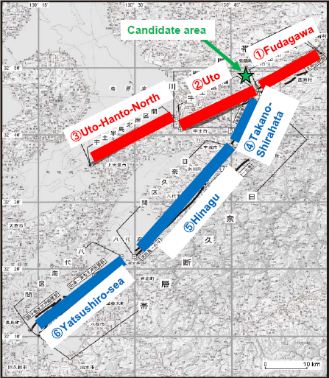
Test Cases
List of Test Cases for Step 1: based on Futagawa fault zone (FFZ) characterization by HERP (2015)
Base Case
Kumamoto Prefectural Office Site: z = 100 m, closest distance site-fault (r = 5.2 km)
Ruptures are combinations of three FFZ segments (in red)
Add logic tree branch alternatives to magnitude and mean rate
Sensitivity Cases
Alternative fault source: SFZ (r = 0.6 km)
Primary fault displacement hazard (r = 0 km)
Add Floating* FFZ source alternative (*see slides 18-19)
Primary hazard, SFZ alternative source
Increase distance from site to FFZ (r = 10 km)

Slide 9
HERP map of sources
Step 1 model of sources
Suizenji
Fault Zone
(SFZ)
1
24 km
0.6 km
5.2 km
Futagawa
Fault Zone
(FFZ)
simplification
22 km
2
3
32 km

Slide 10
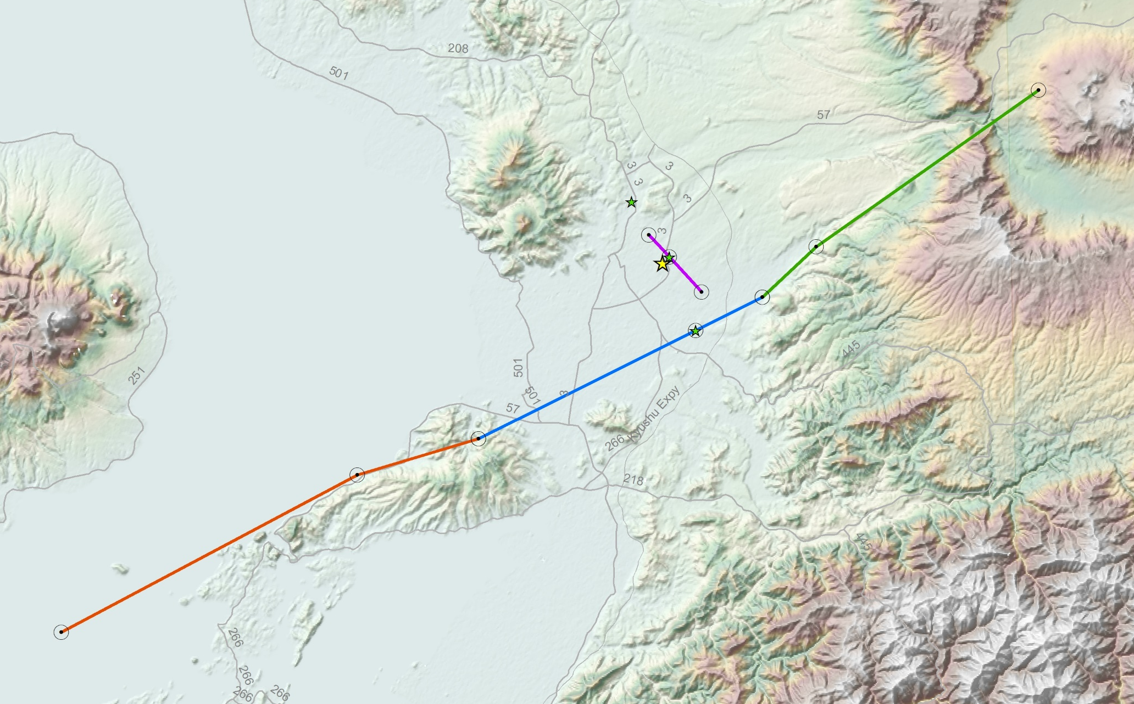


Site and sources coordinates for test cases
Source geometry parameters:
Uto
L = 22 km (l/L = 0.23)
Futagawa + Uto
L = 46 km (l/L = 0.37)
Uto + Uto Hanto North
L = 54 km (l/L = 0.1)
Futagawa + Uto + Uto Hanto North
L = 78 km (l/L = 0.37)
r = 10 km site
Futagawa fault source
SFZ site
Base Case
site
r = 0 site
Uto fault source
All coordinates (lon, lat) are listed in the Excel file and provided in a shapefile
Uto Hanto North fault source

Slide 11
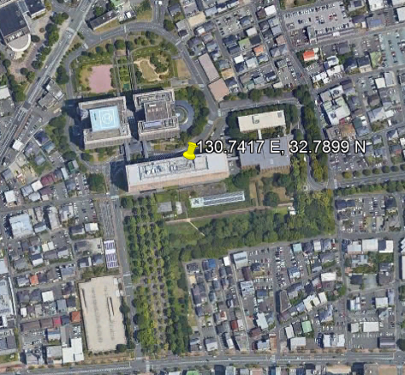
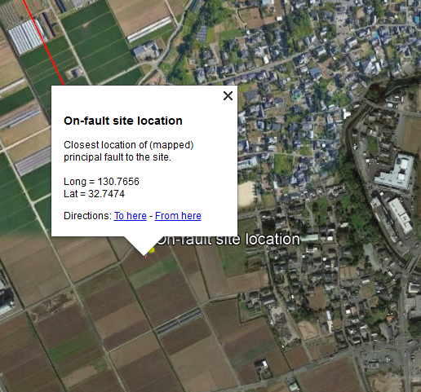
Base Case – Kumamoto Site
Site coordinates (x₁,y₁) – off-fault = 130.7417°, 32.7899°
Site dimension (z) = 100 m × 100 m
Closest Distance, FFZ: r = 5.22 km
Map Accuracy = Approximately Located

Slide 12
Base Case: Distributed fault displacement hazard
FFZ, r = 5.2 km; z = 100 m
1
1
+
+
2
2
+
M 6.9
(24 + 22
= 46 km)
3
M 7.0
(22 + 32
= 54 km)
5.2 km
5.2 km
5.2 km
5.2 km
M 6.5
(22 km)
M 7.2
(46+32
= 78 km)
2
2
+
3

Slide 13

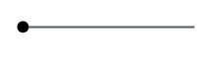
Base Case Source Logic Tree – single path
Max Rupture Length
Max Rupture Thickness
Average Dip
Mean Rate (×10⁻⁵ yr⁻¹)
Fault Source
Mag PDF
Magnitude
Uto (2)
22
14
60° NW
Maximum
Magnitude
6.5
18.9
Futagawa + Uto (1+2)
46
14
68.6° NW
Maximum
Magnitude
6.9
1.28
Uto + Uto-Hanto-North (2+3)
54
14
60° NW
Maximum
Magnitude
7.0
3.53
Futagawa + Uto +
Uto-Hanto-North (1+2+3)
78
14
64.6° NW
Maximum
Magnitude
7.2
1.28

Slide 14
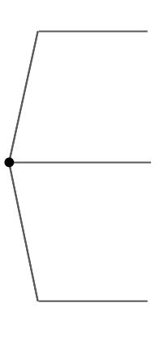
Base Case Source Logic Tree – multi-path. Model epistemic uncertainty in source mag and rate
Max Rupture Thickness
Max Rupture Length
Average Dip
Mean Rate** (×10⁻⁵ yr⁻¹)
Fault Source
Mag PDF
Magnitude*
6.7 [0.2]
56.7 [0.2]
Uto (2)
22
14
60
Maximum
Magnitude
6.5
6.5 [0.6]
18.9 [0.6]
6.3 [0.2]
6.3 [0.2]
Futagawa + Uto (1+2)
46
14
68.6
Maximum
Magnitude
Uto + Uto-Hanto-North (2+3)
54
14
60
Maximum
Magnitude
#
Futagawa + Uto +
Uto-Hanto-North (1+2+3)
78
14
64.6
Maximum
Magnitude
Notes:
# the complete list of parameters is listed in the excel file
*Magnitude uncertainty reflects a factor of 2 uncertainty in seismic moment per event for each source
**Mean rate uncertainty is a factor of 3 about the middle branch

Slide 15
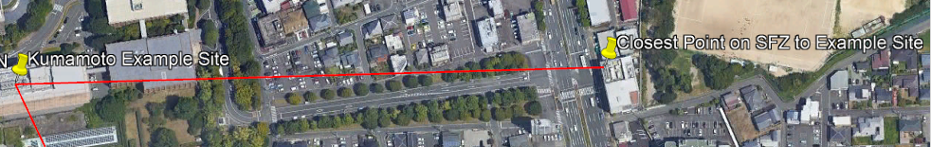
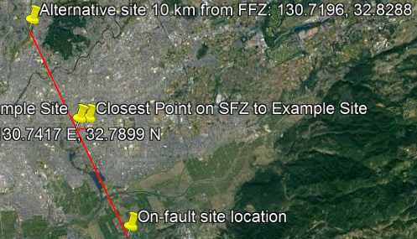
Sensitivity Cases – Kumamoto Site
Case 1: source is SFZ (not FFZ)
Site coordinates (x₁,y₁) – off-fault = 130.7417°, 32.7899°
Site dimension (z) = 100 m × 100 m
Closest Distance, SFZ: r = 0.60 km
Map Accuracy = Inferred
Case 2: site is ON FFZ (principal faulting)
Site coordinates (x₂,y₂) – on-fault = 130.7656°, 32.7474°
Distance r = 0 km
Case 3: site is ON SFZ (principal faulting)
Site coordinate (x₃,y₃) – on-SFZ = 130.7467°, 32.7936°
Closest Distance r = 0 km
Case 4: site is 10 km from FFZ
Site coordinate (x₄,y₄) – off-FFZ = 130.7196°, 32.8288°
Closest Distance r = 10.0 km
Site dimension (z) = 100 m × 100 m
Map Accuracy = Approximately Located

Slide 16
Sensitivity Case 1: Change source to SFZ
SFZ
Tests:
Alternative Framing of Hazard Source
z = 100 m
r = 600 m
0.60 km
M 5.8
(L = 5.4 km)
Source Logic Tree
Max Rupture Thickness
Max Rupture Length
Average Dip
Mean Rate (×10⁻⁵ yr⁻¹)
Fault Source
Mag PDF
Magnitude
Suizenji
5.4
5
60
Maximum
Magnitude
5.8
23.3
Notes:
Maximum magnitude PDF modeled as delta function (single magnitude at stated rate)
The rate is based on 4300 yr mean RI calculated using estimated 0.1 mm/yr slip rate and scaling using HERP methodology

Slide 17
Sensitivity Cases – Kumamoto Site
Case 1: source is SFZ (not FFZ)
Site coordinates (x₁,y₁) – off-fault = 130.7417°, 32.7899°
Site dimension (z) = 100 m × 100 m
Closest Distance, FFZ: r = 0.60 km
Map Accuracy = Inferred
Case 2: site is ON FFZ (principal faulting)
Site coordinates (x₂,y₂) – on-fault = 130.7656°, 32.7474°
Distance r = 0 km
Also test Floating EQs
Case 3: site is ON SFZ (principal faulting)
Site coordinate (x₃,y₃) – on-SFZ = 130.7467°, 32.7936°
Closest Distance r = 0 km
Case 4: site is 10 km from FFZ
Site coordinate (x₄,y₄) – off-FFZ = 130.7196°, 32.8288°
Closest Distance r = 10.0 km
Site dimension (z) = 100 m × 100 m
Map Accuracy = Approximately Located

Slide 18
Sensitivity Cases 2 and 3: Move site onto fault (r = 0); test floating
FFZ, HERP sources
FFZ, branch alt
SFZ, additional
1
1
+
+
M 6.9
(24 + 22
= 46 km)
2
2
+
3
l/L =
0.39
M 5.8
(5.4 km)
l/L =
0.23
l/L
varies
M 6.5
(floating)
l/L =
0.37
l/L =
0.1
l/L =
0.37
M 7.2
(46+32
= 78 km)
2
M 6.5
(22 km)
2
M 7.0
(22 + 32
= 54 km)
+
3
Tests:
Magnitude and l/L variability
How “floating” is treated

Slide 19
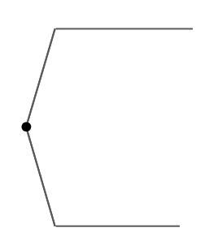
Sensitivity Case 2: Source Logic Tree
Max Rupture Length
Max Rupture Thickness
Average Dip
Mean Rate (×10⁻⁵ yr⁻¹)
Fault Source
Mag PDF
Magnitude
l/L
Floating M 6.5 (1+2+3)
~20
14
64.6
Maximum
Magnitude
6.5
64.2
variable
[0.5]
Uto (2)
22
60
Maximum
Magnitude
6.5
18.9
0.23
14
[0.5]
Futagawa + Uto (1+2)
46
14
68.6
Maximum
Magnitude
6.9
1.28
0.37
Uto + Uto-Hanto-North (2+3)
54
14
60
Maximum
Magnitude
7.0
3.53
0.10
Futagawa + Uto +
Uto-Hanto-North (1+2+3)
78
14
64.6
Maximum
Magnitude
7.2
1.28
0.37

Slide 20
Sensitivity Cases – Kumamoto Site
Case 1: source is SFZ (not FFZ)
Site coordinates (x₁,y₁) – off-fault = 130.7417°, 32.7899°
Site dimension (z) = 100 m × 100 m
Closest Distance, FFZ: r = 0.60 km
Map Accuracy = Inferred
Case 2: site is ON FFZ (principal faulting)
Site coordinates (x₂,y₂) – on-fault = 130.7656°, 32.7474°
Distance r = 0 km
Also test Floating EQs
Case 3: site is ON SFZ (principal faulting)
Site coordinate (x₃,y₃) – on-SFZ = 130.7467°, 32.7936°
Closest Distance r = 0 km
Case 4: site is 10 km from FFZ
Site coordinate (x₄,y₄) – off-FFZ = 130.7196°, 32.8288°
Closest Distance r = 10.0 km
Site dimension (z) = 100 m × 100 m
Map Accuracy = Approximately Located

Slide 21
Sensitivity Case 4: Site farther from principal fault (r > 0)
FFZ, r = 5.2 km
FFZ, r = 10 km
1
1
1
1
+
+
+
+
2
2
2
2
+
+
3
3
5.2 km
5.2 km
5.2 km
5.2 km
10 km
10 km
10 km
10 km
2
2
2
2
+
+
Tests:
Magnitude and “r” variability
3
3

Slide 22
Requested Results
PowerPoint or similar presentation format
Overview of fault displacement model per publication
Definition of the Intensity Measure
e.g., Net fault displacement? Strike-slip or vertical displacement component?
Localized on a single fault within the site? Cumulative offset across the site?
Fault displacement model logic tree for hazard calculation
Presentation of base case results (hazard curves)
Presentation of mean and fractile hazard curves (for base case with epistemic uncertainty)
Presentation of results for sensitivity cases

Slide 23
Requested Results continued
Tabulated results: Hazard for the following displacement amplitudes (cm):
0.01, 0.1, 0.5, 1, 1.5, 3, 5, 7.5, 10, 15, 30, 50, 75, 100, 300, 500, 750, 1000
Graphical results: Hazard curves showing annual exceedance frequency vs displacement (cm)
Base Case Hazard Curves, single source path
Four “marginal” hazard curves and total mean hazard curve
Base Case Hazard Curves, epistemic uncertainty in source
Total Mean Hazard Curve
Hazard Fractile Curves: 5, 16, 50, 84, 95 percentiles
Separate fractiles from source characterization versus fault displacement models (optional)
“Tornado” or other sensitivity plots to examine contribution of parameter uncertainty to total hazard uncertainty (optional)

Slide 24
Requested Results continued
Sensitivity #1
Compare SFZ hazard curve versus Base Case mean hazard curve
Sensitivity #2
Four “marginal” hazard curves and Total Mean hazard curve, r=0
Hazard Fractile Curves: 5, 16, 50, 84, 95 percentiles
Break out fractiles from source characterization versus fault displacement models (optional)
Compare Uto (2) source marginal hazard curve for fixed location versus “floating” characterization
Sensitivity #3
Compare SFZ hazard curve versus Base Case mean hazard curve for r=0
Sensitivity #4
Four “marginal” hazard curves and Total Mean hazard curve, r=10 km

Slide 25
Next Steps: Preparation for Step 2
Procedures for validation and testing results from other groups
How many cases? Which cases? What is tolerance for “validation”?
Scope of Benchmarking in Step 2:
Fault displacement model testing:
Only validate/test as-published median models? E.g., through a set of clear assumptions.
Test/explore different approaches to problem solving and logic-tree development? E.g., provide limited assumptions and allow/encourage more creativity
Source characterization testing:
Is this beyond scope? E.g., IAEA provides all parameters?
Limited scope? IAEA provides all source logic tree values and weights, but groups show sensitivities? This is a code validation exercize?
Within scope? Provide limited assumptions and allow/encourage alternative approaches to solving magnitude-recurrence relationship
Hazard code / post-processing testing? Validate/compare methods for:
Locating earthquake ruptures on a model fault plane (floating)
Computing “r” and “l/L” distances
Calculating the magnitude-recurrence relationship
Calculating hazard fractiles

Slide 26
For any questions and clarification please send an email to A.Valentini@iaea.org
Notes:
Thank you!

